Slide 1
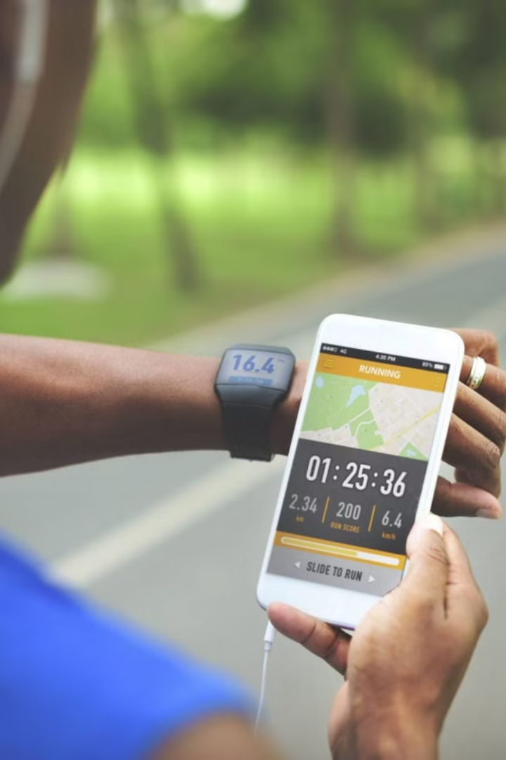
Health and Fitness Recommendations using Machine Learning
This presentation will explore how machine learning techniques like linear regression and K-nearest neighbor classification can be used to provide personalized health and fitness recommendations to improve people's well-being. This is actually realated to user based recommendation systems based on their goals and activity levels.
You mght – fitness trackers and yt finess notification, all these and examples

Slide 2

Introduction to Machine Learning in Healthcare
1
Predictive Modeling
2
Personalized Interventions
Machine learning algorithms can identify patterns in health data to predict outcomes and risk factors. as these kind of models are helpful to track your physical activity levels to set goals to the finest tasks, That you want to set and achieve
ML can tailor treatments and recommendations to individual patients based on their unique characteristics.
This will also be helpful to track all your Metabolic rates everyday and keeps you posting stuff about that, By tracking your calorie burn levels and healthcare kind of things
3
Enhanced Decision Making
ML-powered analytics can assist healthcare providers in making more informed, data-driven decisions.

Slide 3
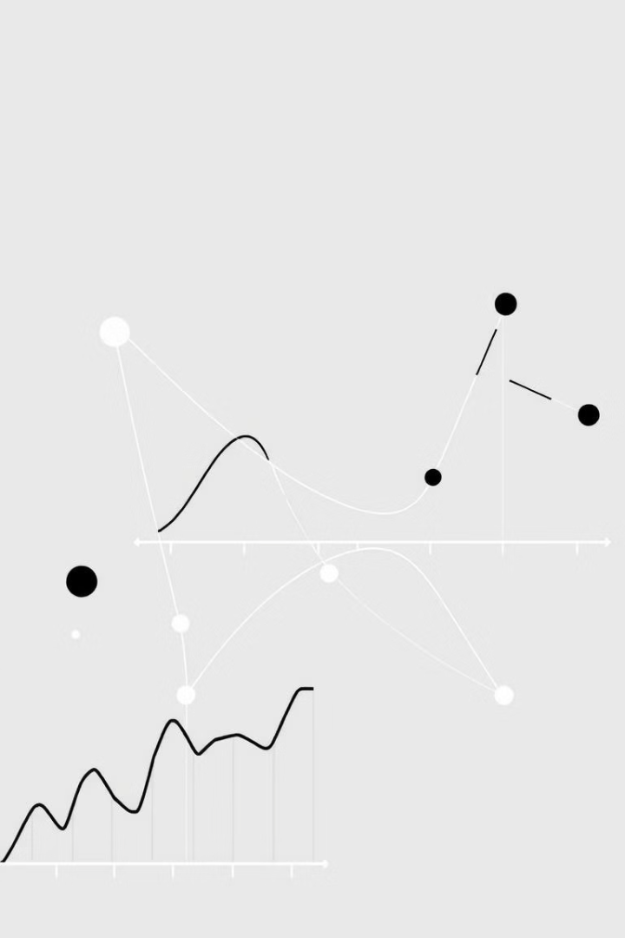
Linear Regression for Predicting Health Outcomes
1
Identify Predictors
Examine factors like diet, exercise, age, and medical history that may influence health outcomes.>> Here I haven’t used pca as this is a recommendation system model
2
Build Regression Model
Use linear regression to establish relationships between predictor variables and target outcomes.
3
Generate Predictions
Apply the regression model to new data to forecast future health metrics like BMI or cholesterol levels.

Slide 4
K-Nearest Neighbor Classification for Fitness Assessments
Gathering Data
KNN Algorithm
Personalized Feedback
Collect information on physical activity, nutrition, and other lifestyle factors from fitness trackers and self-reported data.
Use the K-nearest neighbor classification technique to assign fitness levels based on similarity to known data points.
Provide users with tailored recommendations to improve their fitness levels and overall health.

Slide 5
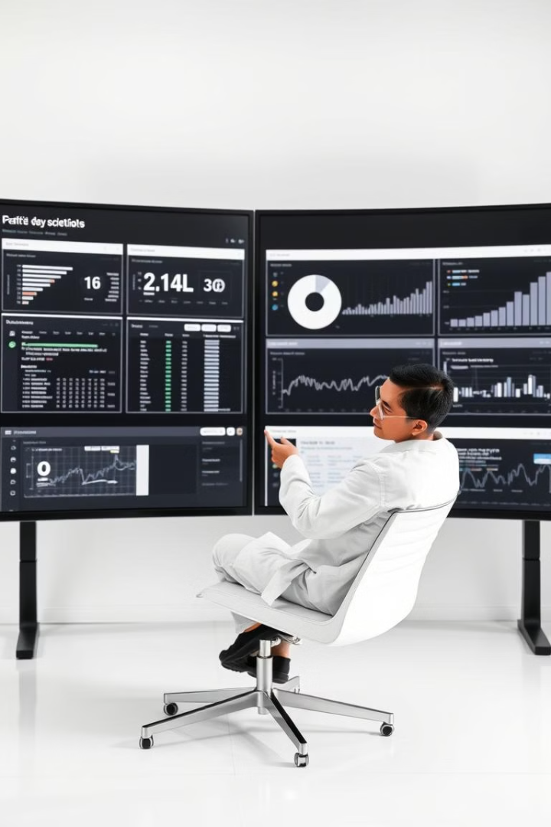
Data Collection and Preprocessing small, compressed and more structured
Wearable Devices
Self-Reported Data
Gather real-time data on physical activity, heart rate, sleep patterns, and other health metrics.
Collect information on diet, stress levels, and other lifestyle factors through user surveys and logs.
Medical Records
Data Cleaning
Integrate historical health data, such as lab results and medical diagnoses, to enrich the dataset.
Preprocess the data by handling missing values, removing outliers, and ensuring consistency.

Slide 6




Developing Predictive Models
Feature Engineering
Create new variables by combining or transforming the original data features.
Model Selection
Choose appropriate machine learning algorithms based on the problem and data characteristics.
Hyperparameter Tuning
Optimize the model parameters to improve its predictive performance.

Slide 7
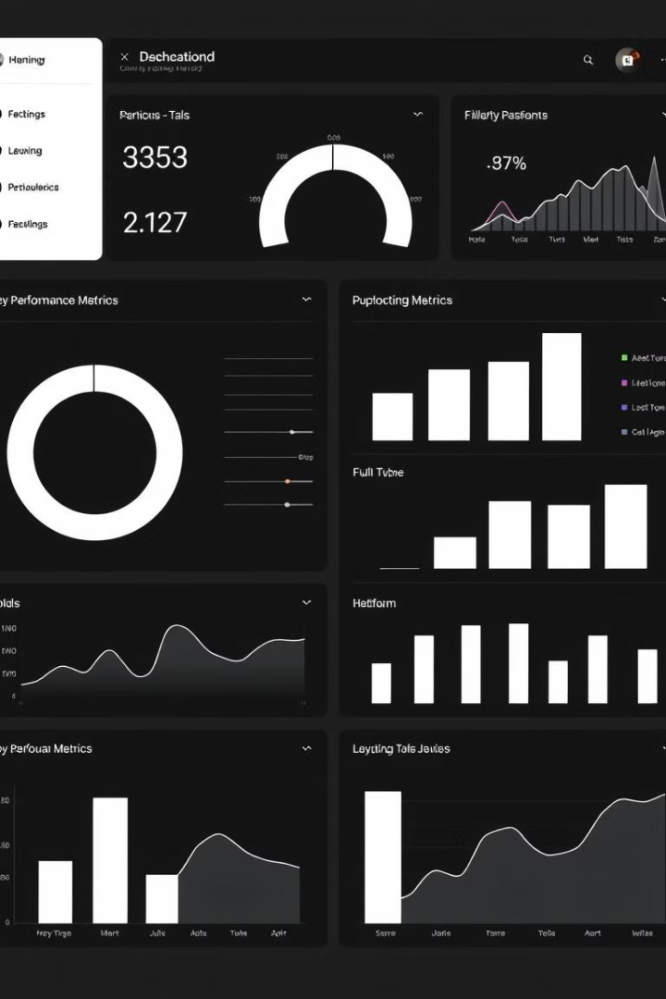




Evaluating Model Performance
Accuracy
Precision
Measure the percentage of correct predictions made by the model.
Assess the model's ability to identify true positive cases accurately.
Recall
F1-Score
Evaluate the model's ability to identify all relevant positive cases.
Combine precision and recall to get a balanced performance metric.

Slide 8

Practical Applications and Future Directions
Health and finess recommendation systems
Real-Time Monitoring
Continuous tracking of health data can enable early intervention and personalized care.
Preventive Care
Predictive models can identify high-risk individuals and recommend targeted preventive measures.
Outcome Optimization
ML-driven optimization of treatment plans and lifestyle recommendations can improve health outcomes.
Scalability and Accessibility
Automated, technology-driven solutions can provide healthcare access to wider populations.

